Slide 1
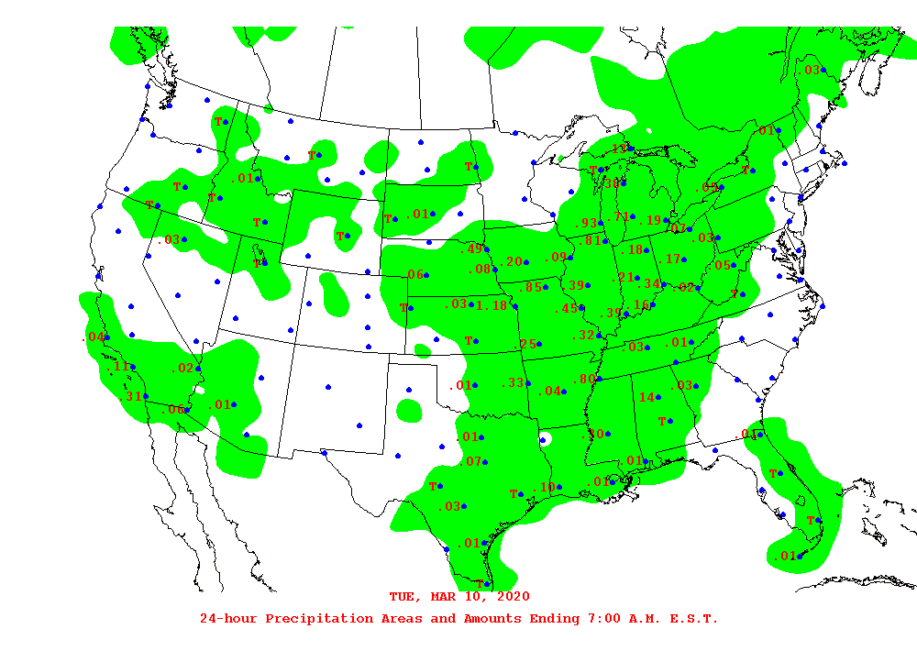
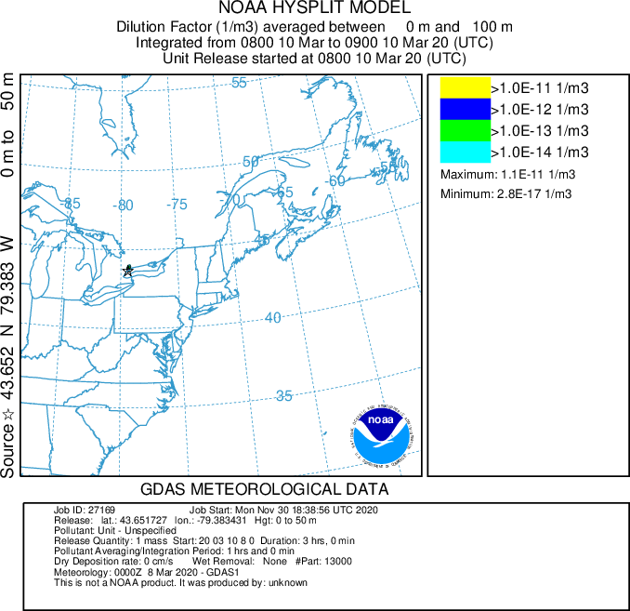
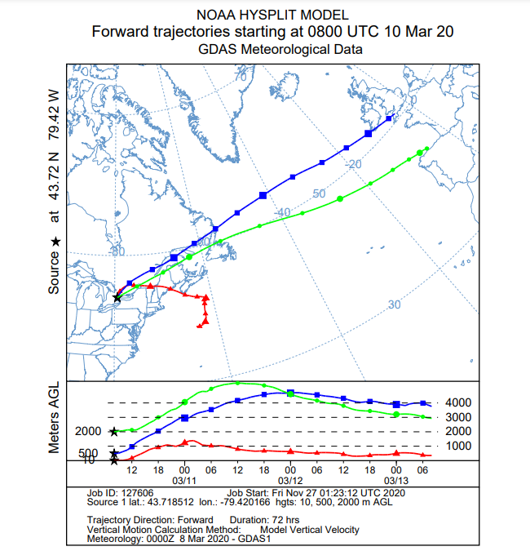
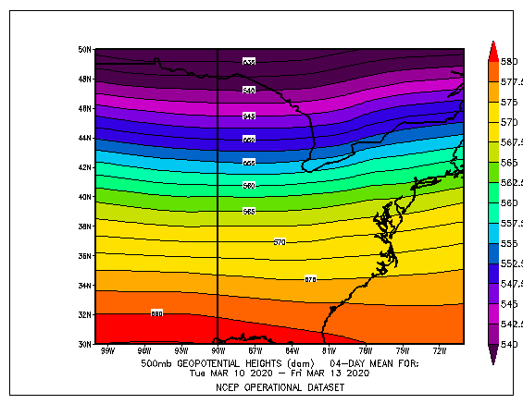
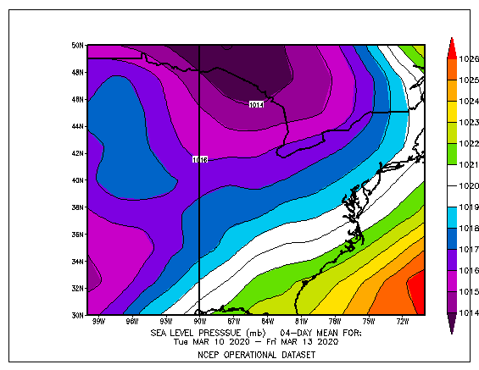
Analysis of COVID-19 Dispersion and Local Meteorology in Toronto
REPLACE THIS BOX WITH YOUR ORGANIZATION’S
HIGH RESOLUTON LOGO
Edmond Chen, Paul Li, Thansy Mahendran, Ali Nakajima-Inglis
University of British Columbia, Department of Geography
REFERENCES
INTRODUCTION
COVID-19 is a coronavirus called SARS-CoV-2. It was first identified in Wuhan, China and quickly spread globally. The disease is an airborne disease which can be spread through saliva, bodily fluids, and excretions. On March 11th, 2020, WHO declared COVID-19 as a global pandemic.
The aim of the study focuses on the pollutant plume transport of COVID-19 viral aerosols by turbulence processes before mixing and diluting into the atmosphere and losing potency. Thus, local meteorology including ambient stability factors (or conditions) will be considered in relation to the potential viral transmission in Toronto.
Another most commonly associated mesoscale (wind) process is the effect of warm and moist sea breeze from the Atlantic Ocean, which may also increase the survival chance of the virus as it relies on moisture to survive (Bhaganagar & Bhimireddy, 2020). The formation of sea breeze due to pressure gradients between the land and water often drives predominant easterly winds from the coast towards the inlands of the eastern North America, which is consistent with Figures 1 & 2. These easterly winds transport the emissions of pollutants (including precursor species) from more coastal cities westwards into Toronto, which may contribute to increasing viral aerosol concentrations. As the HYSPLIT model simulations are conducted for March 10th to 12th, the concentrations might be higher due to more intense high-pressure anticyclones in generating greater subsidence inversion events in Spring-Summer time. The effect of mesoscale sea breeze is also stronger, where near-ground temperature and pressure gradients are often the greatest, leading to higher concentrations in March.However, we can only demonstrate correlation between local meteorology (including pollution) and viral transmission rather than causation in our study due to their complex interaction. Further, Bontempi (2020) demonstrates that it is not possible to conclude that COVID-19 diffusion mechanism also occurs through the air, by using PM₁₀ as a carrier. Rodó et al. (2011) also produces a similar conclusion that there has been no evidence of long-range transport of an infectious agent causing human disease, despite links between human respiratory disease and large scale dust transport are well-established.
The scenario chosen is inappropriate for conducting the analysis of air quality (aka pollutant levels) in Toronto during the COVID-19 State of Emergency (SOE) because of the choice of a shorter period (March 10th to 12th). Previous study has selected a five-week period during the SOE and compared with the same period in previous five years (Adams, 2020). Time lags (or lag effects) of pollutants should be considered to allow for accumulation and exhibiting discernible changes in concentrations, which could range from 7, 15, 21 to 30 days (Hoang & Tran, 2020). Hence, it would be better to conduct future research on this topic with pollutant data from a wider range of dates in the municipality of Toronto. We can see from Table 1 that there is almost no difference between the PM_{2.5} and NO₂ concentrations from 2019-20, suggesting a dearth of pollutant data from a wider range of dates for the analysis; however, the O₃ concentrations are surprisingly lower in 2020 for all four stations in Toronto, which might be attributed to weather patterns from March 10th to 12th (Figure 3) where precipitation predominates (aka no sunlight and thus photochemistry involved in producing secondary pollutants like O₃).
Adams, M. D. (2020). Air pollution in Ontario, Canada during the COVID-19 State of Emergency. Science of The Total Environment, 742, 140516. https://doi.org/10.1016/j.scitotenv.2020.140516
Bhaganagar, K., & Bhimireddy, S. (2020). Local atmospheric factors that enhance air-borne dispersion of coronavirus-High-fidelity numerical simulation of COVID19 case study in real-time. Environmental research, 191, 110170. https://doi.org/10.1016/j.envres.2020.110170
Bontempi, E. (2020). First data analysis about possible COVID-19 virus airborne diffusion due to air particulate matter (PM): the case of Lombardy (Italy). Environmental Research, 109639. https://doi.org/10.1016/j.envres.2020.109639
Hoang, T., & Tran, T. T. A. (2020). Ambient air pollution, meteorology, and COVID‐19 infection in Korea. Journal of medical virology. https://doi.org/10.1002/jmv.26325
National Weather Service Weather Prediction Center. (n.d.). WPC Weather Archive. Retrieved from https://www.wpc.ncep.noaa.gov/archives/web_pages/wpc_arch/get_wpc_archives.php
NOAA Physical Sciences Laboratory. (n.d.). Atmospheric Variables Plotting Page. Retrieved from https://psl.noaa.gov/data/histdata/
NOAA Physical Sciences Laboratory. (n.d.). HYSPLIT. Retrieved from https://www.ready.noaa.gov/HYSPLIT.php
Ontario Ministry of the Environment, Conservation and Parks. (2010). Air Quality Ontario. Retrieved from http://www.airqualityontario.com/
Rodó, X., Ballester, J., Cayan, D., Melish, M. E., Nakamura, Y., Uehara, R., & Burns, J. C. (2011). Association of Kawasaki disease with tropospheric wind patterns. Scientific reports, 1, 152. https://doi.org/10.1038/srep00152
Figure 3. Precipitation map for March 10/2020
Figure 4. 72-hour concentration run of the hypothetical viral plume done with point source at Toronto
METHODS AND MATERIALS
For the trajectory run, we picked the point source location in Toronto using the GDAS 1 degree dataset as that one allowed us to go back to March of this year for a HYSPLIT analysis.
In addition, two synoptic maps were plotted at 500 mb and sea level pressure (SLP). The synoptic weather conditions on March 10th and throughout this duration were partly sunny and the wind conditions were fairly calm.
A concentration run was also done for this region to simulate how a viral plume would disperse with time. The relative closeness of the isobars for this day suggests relatively strong wind speeds.
Table 1. Table of concentrations comparing O₃, PM_{2.5} and NO₂ between March 10 - 12 for 2019 and 2020
RESULTS
Interestingly, the HYSPLIT model shows that during this 3 day period, a hypothetical viral plume would be lifted even higher above ground level (AGL). At 500 and 2000 m AGL, HYSPLIT shows the viral plume would travel all the way across the Atlantic ocean and arrive at Europe by the end of the 3 day modelling duration. At 10m AGL which is the more interesting height as this is close to the surface, HYSPLIT shows that the viral plume would increase in elevation and then come closer to surface elevation. Its trajectory shows that it would cross over to a few northeastern US states before finally making its way to the Atlantic ocean. As for the average concentrations of certain particulates and the viral plume, it seems like the synoptic meteorology has concentrated it before allowing it to disperse as it follows a certain trajectory.
Figure 5. 72-hour HYSPLIT trajectory map with source located at Toronto for March 10/2020
DISCUSSION & LIMITATIONS
CONCLUSIONS
The spatial patterns of the spreading of the COVID-19 indicate the possibility of airborne transmission of the coronavirus, which is dictated by the conditions in the local atmospheric boundary layer (ABL). Atmospheric stability regimes that result in low wind speeds, low level turbulence and a shallow ABL favor the transmission of the disease. The wind directions dictate the transport and dispersion of the pollutant plume carrying the viral aerosols (Bhaganagar & Bhimireddy, 2020), which is consistent with our case from March 10th to 12th (Figures 1 & 2). In our “back of the high” scenario, the synoptic scale anticyclone conditions dominate the east coast of North America, leading to the movement of warm and moist air from the Atlantic Ocean and the subsidence with a shallow boundary layer. Specifically, sinking/subsiding air compresses and warms in the high-pressure zone, resulting in horizontal motion at the base of boundary layer, leading to the creation of subsidence inversion just above the shallow mixed layer.
A very stable atmosphere is indicated by the synoptic “back of the high” scenario resulting in low wind speeds, low level turbulence and a shallow ABL that favor the COVID-19 transmission.
Mesoscale processes like warm and moist sea breeze dictates the wind directions which dictate the easterly transport and dispersion of the pollutant plume potentially carrying the viral aerosols into Toronto, which may also indirectly increase the survival chance of the virus.
These conditions may be intensited in March in Spring-Summer time, resulting in higher viral aerosol concentrations.
The study only establishes the link between local meteorology (including pollution) and potential viral transmission in Toronto as there has been no evidence on causation in past studies yet.
Figure 1. 72-hour average synoptic pressure map at 500mb for March 10/2020 in the Toronto region
Figure 2. 72-hour average synoptic pressure map at SLP for March 10/2020 in the Toronto region

